Slide 1
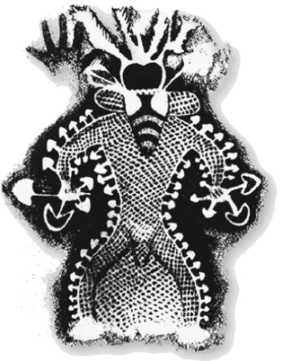

Slide 2
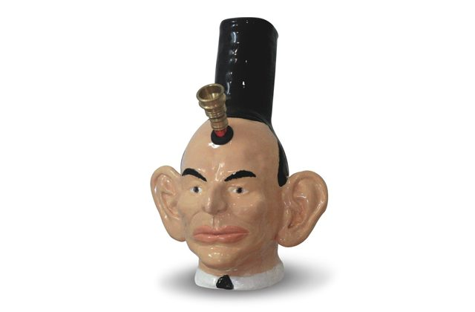
An Online Australian Drug Discussion
How do drug users understand drugs?
How do drug users understand drug policy?
What insights can these understandings offer to harm reduction policy makers?
https://www.facebook.com/anonlineaustraliandrugdiscussion/
https://anonlineaustraliandrugdiscussion.wordpress.com/

Slide 3
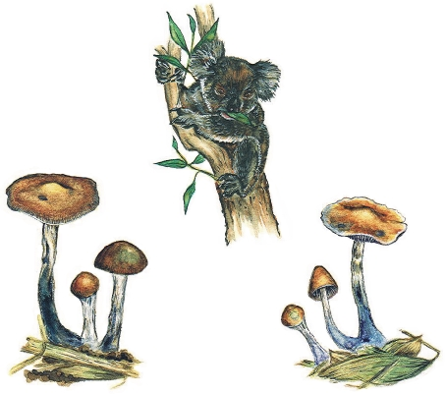
We need to learn more about alternative drug policy models.
Harm reduction is not enough.

Slide 4
…but the problem is bigger than drug policy.
The problem is with how political systems are designed.
Political systems need to be more reflexive, or alternative drug policy won’t work.

Slide 5
Why should we trial self-regulated drug user communities?
Because drug user communities provide better drug user care than government services.

Slide 6
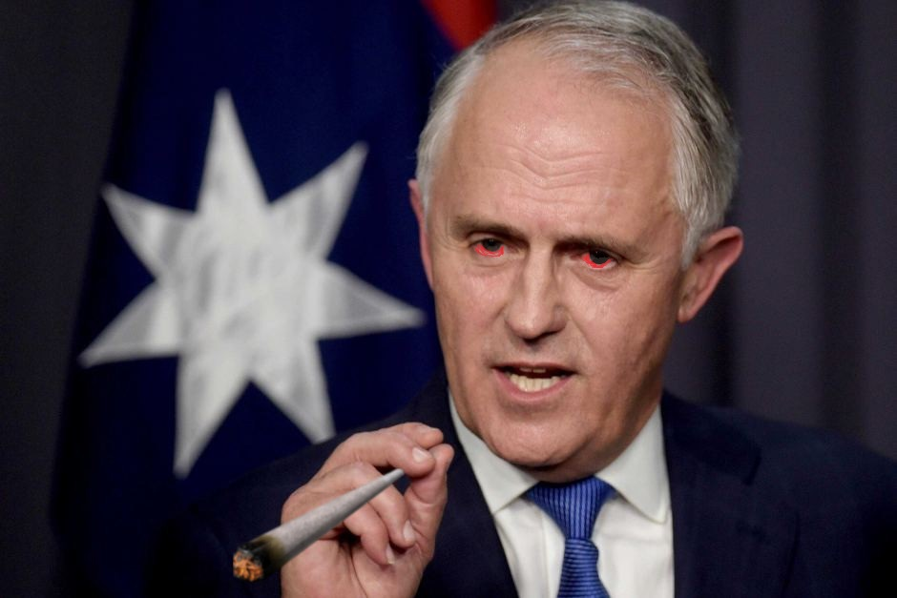
https://www.facebook.com/anonlineaustraliandrugdiscussion/
https://anonlineaustraliandrugdiscussion.wordpress.com/

