Slide 1
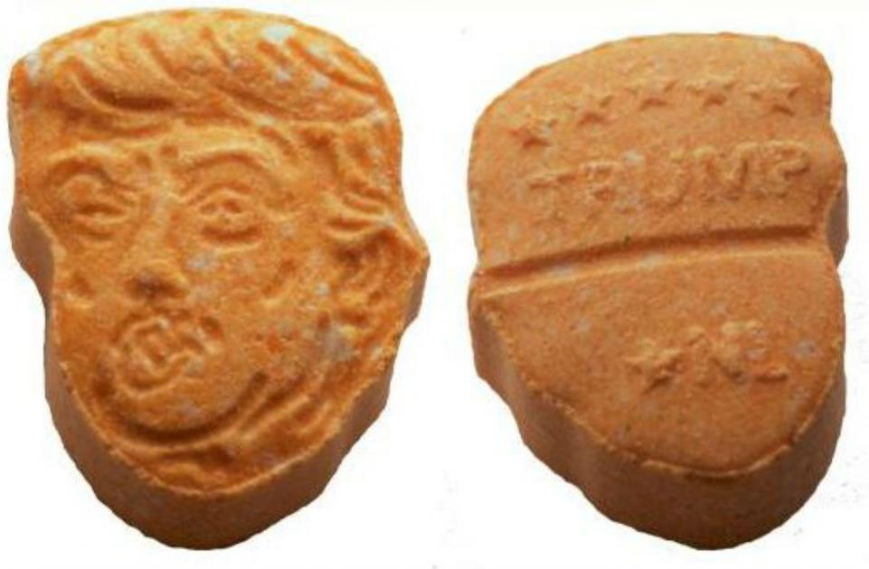
An Online Australian Drug Discussion:
Illicit Drug Policy and the Australian Drug Discussion (AusDD) forum

Slide 2
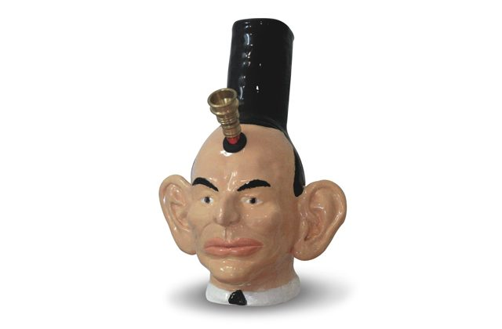
Research question components
1) How do AusDD participants understand drugs?
2) How do AusDD participants understand drug use?
3) How do AusDD participants understand drug policy?
4) What are the implications of these understandings for harm reduction policy makers?

Slide 3
Participant inclusion strategies
Participant as lead researcher
Participant as research advisor
Maintenance of online presence
Bluelight administration approval

Slide 4
Ethical management of criminalising discussion
Data protection and privacy
Published forum content made unsearchable via Google and Bluelight
Coding content that makes users identifiable
Providing participants with opt-out opportunities

Slide 5
Braun and Clarke’s (2006) Thematic Analysis
1) Familiarisation with data
2) Coding
3) Searching for themes
4) Reviewing themes
5) Defining and naming themes
6) Writing up

Slide 6
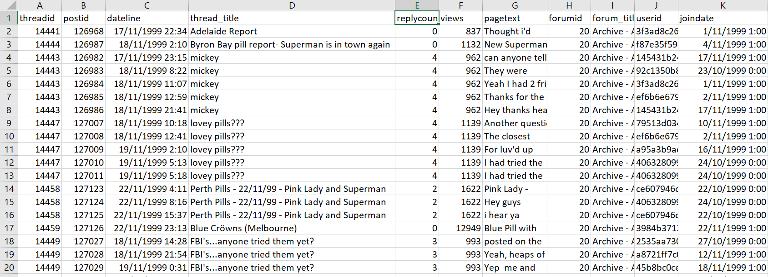
Data corpus (~272 000 posts) in Excel

Slide 7
Figure 1: Data delimitation framework
 | Generic drug terms | Generic policy terms | Policy timelines | Lexical choices | Engagement metrics | Saturation | Theory based terms
AusDD |  |  |  | X |  |  | X
Cannabis policy | X | X | X
NPS policy | X |  | X | X
Natural high policy | X | X |  | X | X
Enabling environments |  |  |  | X |  | X | X

Slide 8
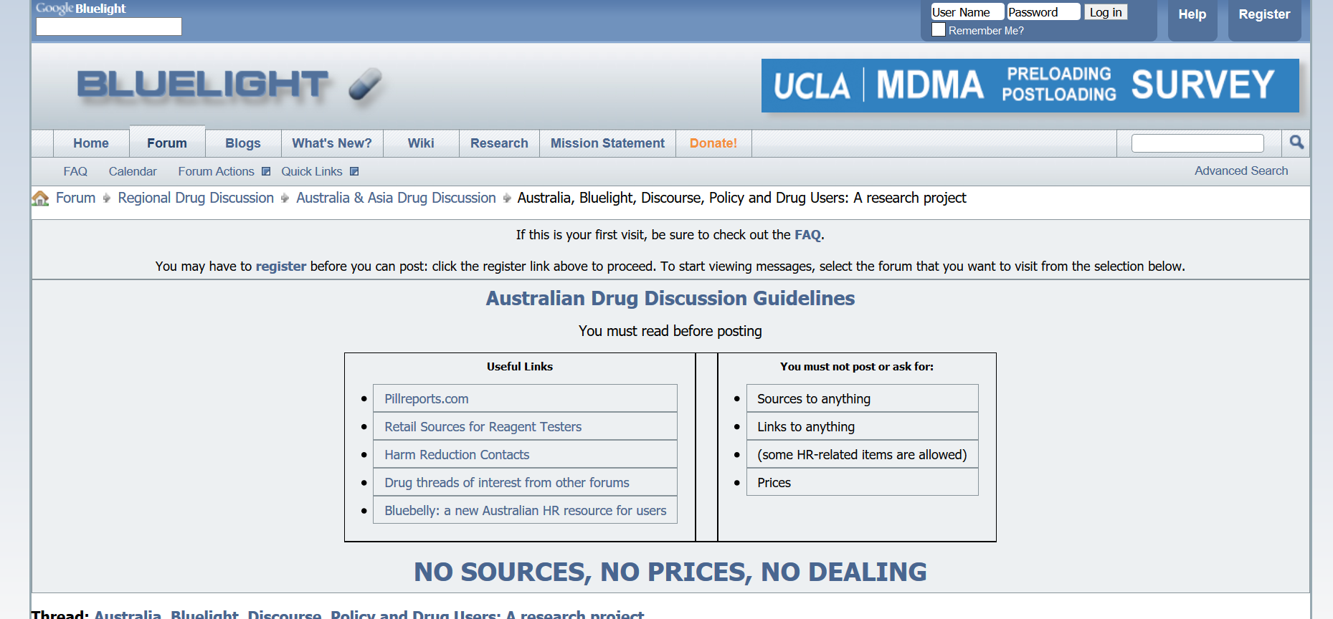
AusDD Analysis
One delimitation strategy used - lexical choices. Included:
drug (~55 000 posts);
abuse (~4 000 posts) ;
addict (~10 000 posts);
harm reduction (~2 500 posts).

Slide 9
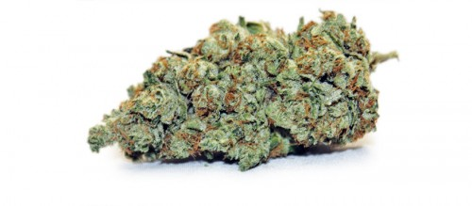
Cannabis policy analysis
Three delimitation strategies used - generic drug terms, generic policy terms and policy timelines.
46 posts relevant to Cannabis policy timelines in 12 threads. 12 threads contained ~2 500 posts that used a general Cannabis search term.
Delimitation of these ~2500 posts via generic policy terms resulted in:
20 posts containing policy design terms
187 posts containing political process/product terms, and
236 posts containing sociocultural grouping terms
242 posts in the Cannabis policy data set

Slide 10
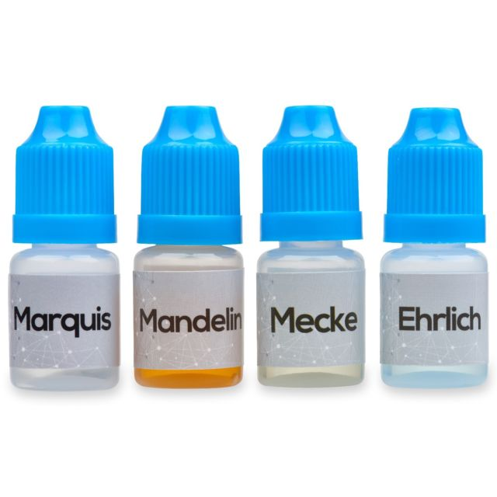
New psychoactive substances (NPS) policy analysis
Three delimitation strategies used - generic drug terms, policy timelines and lexical choices.
19 posts relevant to the NPS timeline occurred in 8 threads. In these 8 threads ~140 posts used a generic NPS term.
Removing duplicates, media articles and irrelevant posts left 47 posts in the final NPS policy data set.

Slide 11
Natural high policy analysis
Three delimitation strategies used - generic drug terms, generic policy terms and lexical choices.
List of generic natural high terms used to locate preliminary natural high data. Generic policy search terms were applied to threads using generic natural high terms with over 50 replies,
resulting in:
400 posts containing sociocultural grouping terms
60 containing policy design terms
460 containing political process/product terms
Refinement resulted in a final natural high policy data set consisting of 257 posts.

Slide 12
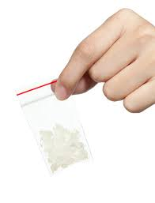
Enabling environment analysis
Places and resources search terms result in two data sets consisting of over 20 000 posts.
Posts ordered by thread and threads ordered by reply count.
Posts reviewed in threads in accordance with code saturation.
The final place data set consisted of 98 posts and the final resources data set consisted of 250 posts.

Slide 13
Harm reduction: A intermediary concept connecting pro and anti-drug philosophies
liam-engel@hotmail.com

