Slide 1
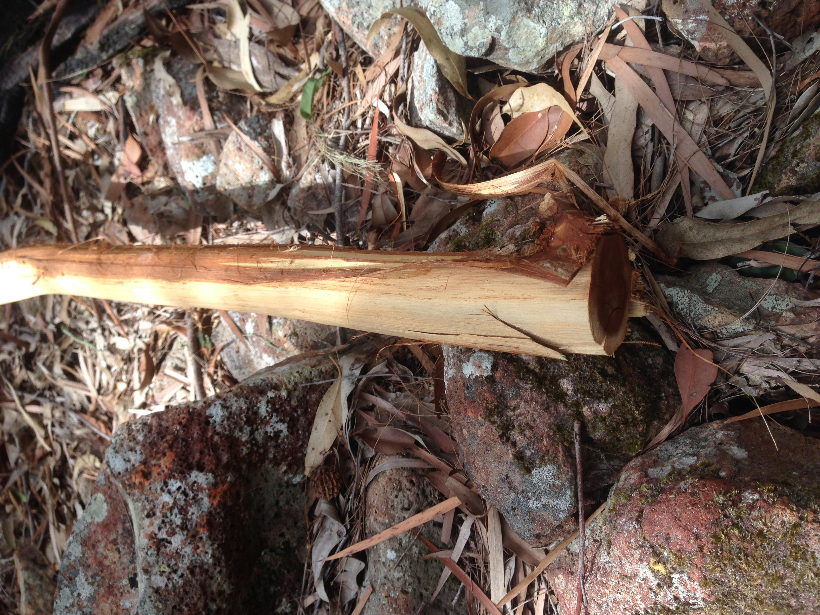
Notes:
Acknowledge country – Darug, Gundungurra and Wadi Wadi people
Acacia sp. thread – poaching discussion
Estimated only about 3000 in the wild
Invasive and threatening harvest techniques

Slide 2
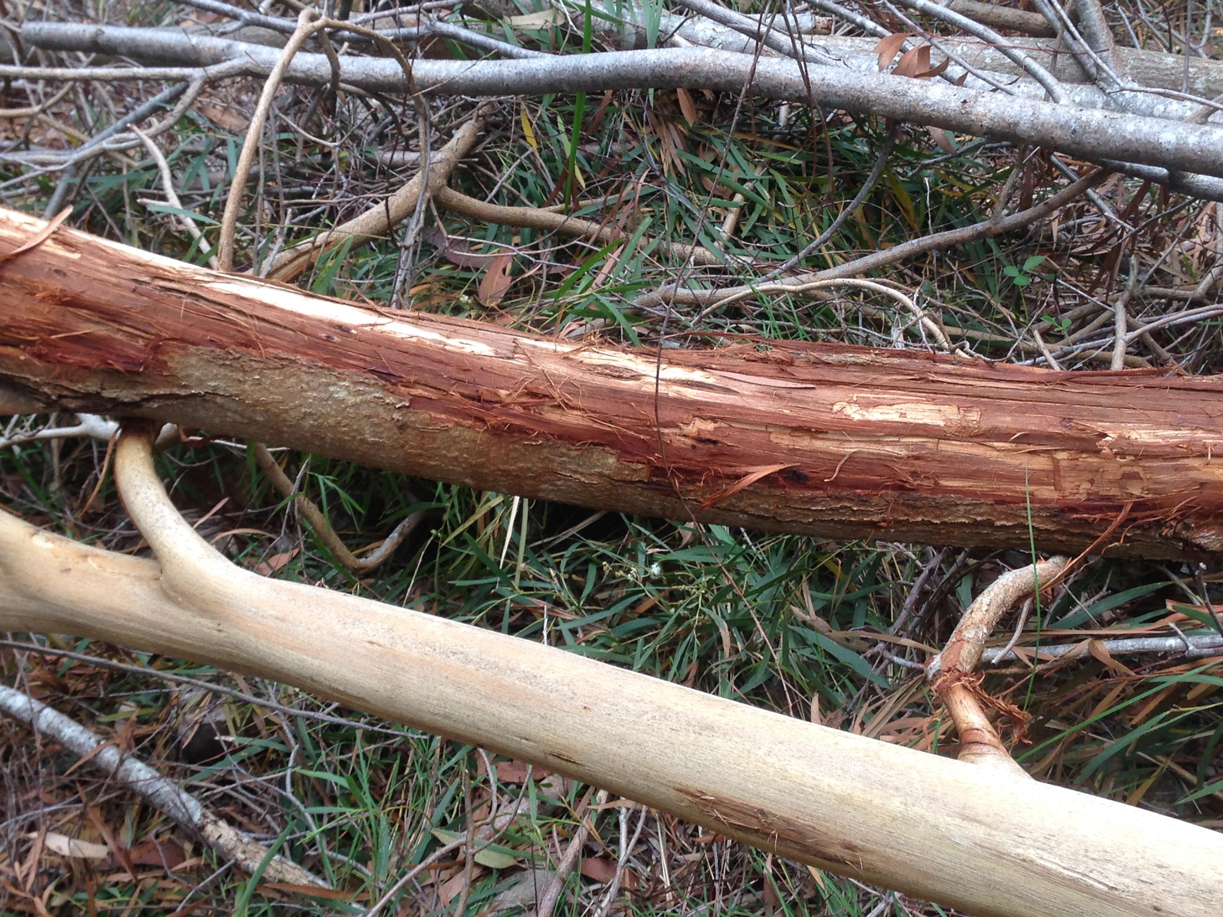
Notes:
Group forum message – strategy
Cameras? Messaging? Signage? No action. Cameras – legality and police apprehension; messaging – attention to source and cultivators/consumers/producers; signs – beauracracy/legality

Slide 3
Notes:
Conference presentation – who has tried DMT? Who knows the source of their DMT?
Maybe you would understand this picture better if you had.

Slide 4
Notes:
Messaging campaign – preference DMT/Acacia extracts from cultivated source
Pdo example – prosciutto Toscano Italy, stilton cheese

Slide 5
Notes:
30+ rounds of feedback participants included Orgs + community elders; entheobotanical community (intersection of botanists and people who use psychedelics) entheogen + ethnobotany
Also representatives of Traditional Owners local to the Acacia of concern and the NPWS – respected independent authorities.

Slide 6
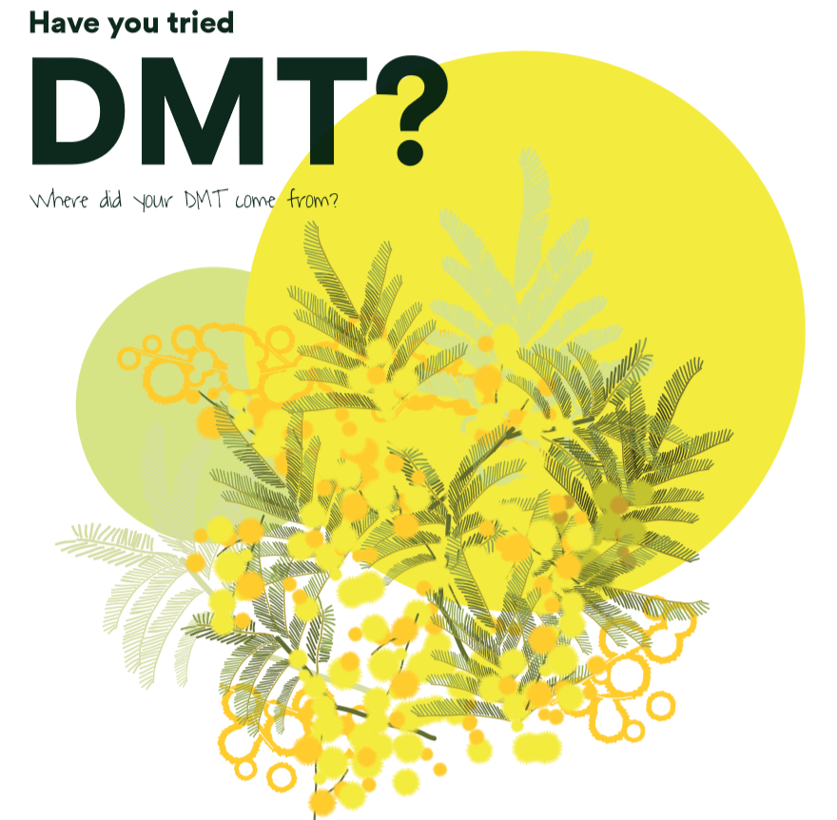
facebook.com/conseracacian
instagram.com/conseracacian
conseracacian.com
Notes:
+ festivals and forums

Slide 7
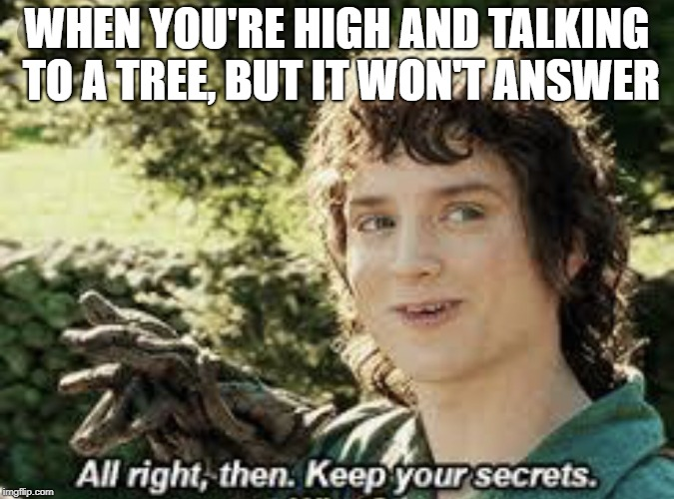
Notes:
Acacia sp. X – maybe less secret in spoken word and private context
Hiding name to protect from further wild harvest

Slide 8
‘‘I think the TGA prohibiting of Salvia relied on a specific forum as their reference for salvia abuse due to the extensive discussion about it. This is what happened with Kratom too’.
Notes:
Private knowledge as harm reduction (reducing harm to source) information poverty – limited resources representing world view and engage in deception to maintain control

Slide 9
Notes:
Balance HR and conservation (remove interactions and HR detail for weighting)

Slide 10
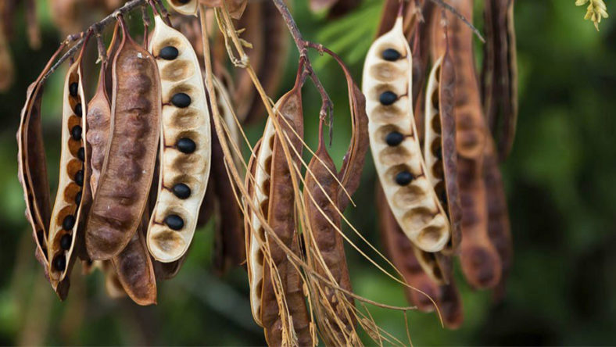
Notes:
Wild harvest (flyer says no, but can be necessary)
Best example is seed – of this species of concern it is illegal to collect seed even tho 3000 wild. There are now well over 4000 cultivated plants, and this is due to wild harvest, cultivation and distribution by mainly one person. Agreement no need for more wild seed collection, but law had to be broken to save the species.

Slide 11
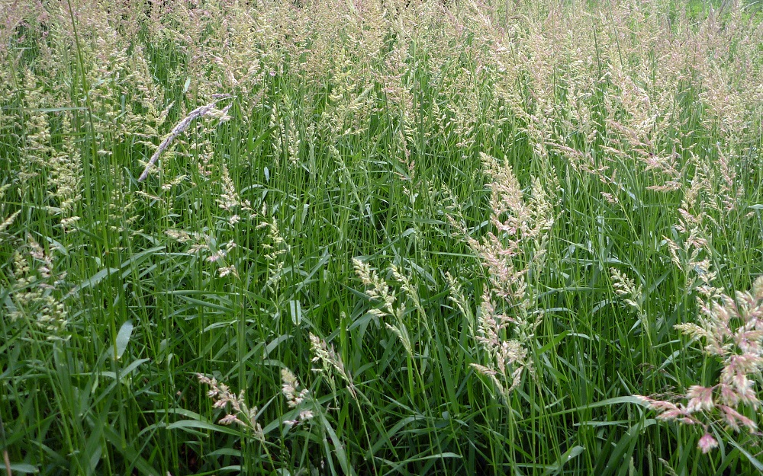
Phalaris
Notes:
Alternative source - Phlaris grass! More politically complicated to suggest a source/manufacture

Slide 12
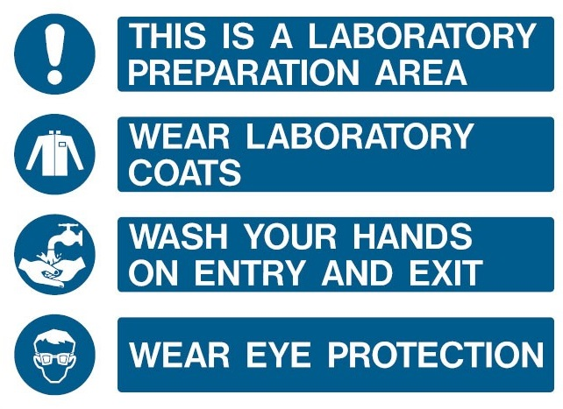
AN ORNAMENT
Notes:
No manufacture discussion - ‘for ornamental reasons’ – obviously people will grow for consumption, but we avoid addressing manufacturers and target consumers for politically simplicity – can manufacturers be addressed in HR? often not in Australia at least because harm is separated from the market (supply and demand red). Harm concerns consumers alone?

Slide 13
‘from a harm reduction perspective smoking suboxone is not a good idea, you don’t know what you are inhaling besides pill binders and buprenorphine. It could be cost effective but you should consider your health too, we definitely can’t encourage pill smoking the best way to consume a drug’.
‘I must have a different definition of harm reduction. I think if someone proposes to ingest a particular drug in a particular way, the harm reduction response should determine what the potential harms of the proposal are, investigate how said harms can be reduced followed by the provision of all this information in complete form so people can make their own informed choice... Now regarding smoking suboxone, it is hard to identify the relevant harms. I know this is practice is not uncommon - certainly it is prevalent in Australian prisons. The miniscule quantities that people are getting to smoke in prison likely reduces the potential harms from inhaling heat maize starch vapour (the main binder). And it's certainly better than injecting while in prison as there is no clean injecting paraphernalia available. My harm reduction advice is - it's safer to take as intended, but if you do smoke suboxone, be aware that it is likely causing damage. Be wary of symptoms like sore throat, breathing difficulties, chest pains, wheezing etcetera. Really there is a whole research project for someone with the resources- what are the potential harms from smoking suboxone?’
Notes:
conflict with perspectives on harm reduction (if they do it anyway, how do we make it more safe) – NPWS more like the first, entheobotanical community more like the second (wild harvesting Acacia is not a good idea vs. how to wild harvest with minimal species impact)

Slide 14
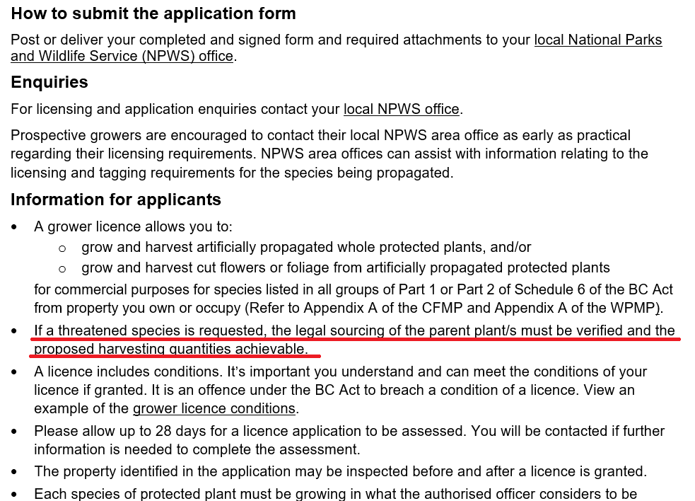
Notes:
License needed for cultivation. Illegal cultivation is conserving the species. I know many people growing this plant, I do not know of anyone doing so with a license. Consulting with traditional owners of the home of this Acacia, they expressed a desire to conserve and cultivate themselves. I am currently trying to obtain licensing to legally cultivate for myself to support this goal, but legal sourcing isn’t possible, or indeed ETHICAL?
Ethics of human intervention and plants – plant ethics committee? Die in the wild or live in a greenhouse? what if consumption of an unethically obtained plant inspires a desire to help the species in future – I suspect this has happened with many people in the case of this specific Acacia species but I think this is actually a trend in ethnobotanical community)
License additional benefit = formal recognition of provenance/genetics (protecting against complications with future hybrids) as well as legal protection and discouraging wild source

Slide 15
Land owner consent must be obtained first, and a licence may be necessary.
“Rather than telling people what to do (especially since they are things no one will ever do while DMT is illegal) it might be better to point out the actual offences.”
Collecting any plant material from Australian state or national parks is illegal without a licence, and collection from other locations may be considered trespassing, stealing, vandalism, and intent to manufacture.
Notes:
NPWS requested we use the top quote, but following advice in the middle we changed it to the bottom quote. Rather than telling people they had to get consent, we told them it may be considered stealing. (This was the wording of NPWS) Leading statements and questions, rather than prescription prescription – although we do prescribe two things and there are limitations - grow (are there bad Acacias to grow, or wrong contexts? – international context, Eucalypt example); refuse wild harvest (there are some contexts –

Slide 16
“’DMT effects last 5–20 minutes, with after effects lasting 1–2 hours.’ I have not found synth DMT to have such long after effects, so I think these are mostly due to other constituents. This effect should be linked to acacia extracts rather than DMT I think.”
https://erowid.org/experiences/subs/exp_Acacia.shtml

Slide 17
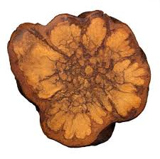
MAOI - a/b
reversible
selective
Harmalas (harmine, harmaline, harmalol) = Banisteriopsis caapi
Ayahuasca (MAOIa) + MDMA = ☹ Kava (MAOIb) + Amphetamine = ☹

Slide 18
Notes:
Aya and cultural appropriation – pharmahuasca? Anahuasca?

Slide 19
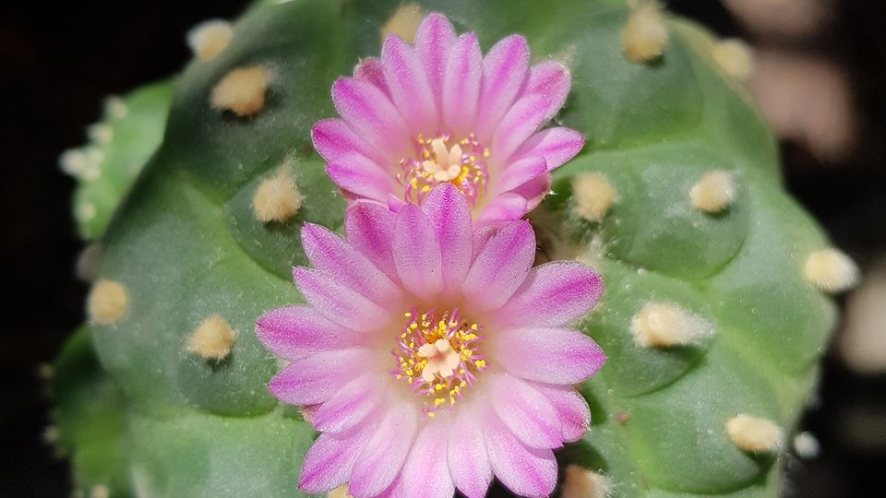
Notes:
Other plants?
Vulnerable - L. williamsii? – the message is clear, discourage wild sourcing
Without vulnerable status – T. peruvianus? – when is wild harvesting permissible? sometimes?

Slide 20
