Slide 1
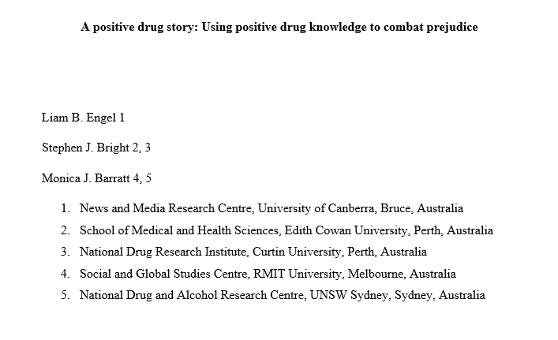

Slide 2
Participant Ethics
Cumulative 30+ years of Bluelight.org participant experience
Community consultation
De-identification
Opt-out/opt-in opportunities
Data agreement
Financial compensation
University of Canberra’s Human Research Ethics Committee (16-146)

Slide 3
Initial Project
Aimed to include people who use drugs in drug policy discourse and deliberation
Qualitative thematic analysis of AusDD (Australian Drug Discussion)
Current Project
Drug positive discourse
Qualitative thematic analysis of original qualitative thematic analysis

Slide 4
Key Terms
Qualitative thematic analysis
AusDD – Australian Drug Discussion
Drug positive discourse

Slide 5
Qualitative Thematic Analysis
Braun and Clarke (2006)
(i) familiarisation with data;
(ii) coding;
(iii) searching for themes;
(iv) reviewing themes;
(v) defining and naming themes;
(vi) writing up

Slide 6
1997 Bluelight.org
1999 Australian Drug Discussion (AusDD)

Slide 7
Dominant, Negative Drug Discourses
evil, dangerous and criminogenic (Bright, Marsh, Smith, & Bishop, 2008; Willis, 2016)
deviant, diseased (Bright, et al. 2008)
reckless (Barratt, Allen and Lenton, 2014)
passive agents of moral ills/pathologised addiction (Fraser et al., 2017)
Prohibition = = drug discourse = people who use drugs

Slide 8
Positive Drug Discourses
drug discourses = + self-management (von Hippel et al., 2018)
+ ?
? social capital
? wellbeing
? mental health
? physical health
drug discourses = - agency (Bright, Kane, Bishop, & Marsh, 2014)
- health service access (Kulesza, Larimer, & Rao, 2013)
- service quality (Van Boekel, Brouwers, Van Weeghel, & Garretsen, 2013)
+ self-stigma (Jones & Corrigan, 2014)
+ physical health issues (Ahern, Stuber, & Galea, 2007)
+ mental health issues (Birtel, Wood, & Kempa, 2017)

Slide 9
Positive-ish Drug Discourses in Research
Counter-public health (Barratt et al., 2014)
Paraphernalia provision (Lancaster, Seear, & Treloar, 2015)
Neoliberal/respectable (Askew & Salinas, 2018)
Recreational (Rødner, 2005)
Disciplined (Järvinen, 2017)
Consumerist (Bright et al., 2008)
Pleasure (Dwyer & Moore, 2013)

Slide 10
Drug Positive Discourse in AusDD
Pleasure
Self-Affirmation, Benefit Maximisation
Experiential Drug Knowledge Diverse Subject Positions
Negative Term Subversion
Harm Reduction

Slide 11
Examples From AusDD

Slide 12
Pleasure and Context
‘To sway the media, we need well presented people with respected social status backing HARM REDUCTION, not PRO-DRUG or pleasure ideologies’.
‘I don't really see a harm in a bit of social chatter, it is a bit of fun. We are all here for HR, but if there was no fun or sense of community I don't think many would of stayed. I don't see it as bluelights job or goal to look good in the eyes of cops, politicians, media, teachers, or any of that shit. We aren't here to change opinions, we are here to give information. I would ask, where is the REAL HR in curbing open and honest drug pleasure discussion in the name of the already impossible goal of making this site look respectable to the anti drug community?’

Slide 13
Pleasure Diversity
‘Do not think of it simply as sharing a drug. Look at it like sharing a sacrament, a piece of the divine, with a person you love and care about’.
‘The drug addiction topic goes straight into the very heart of society. I think people who become addicted to drugs are more spiritually aware than your average person, even though they may not acknowledge it’.
Carnal, disciplined, ascetic, and ecstatic drug pleasures (Bunton, 2011).

Slide 14
Diverse Harm Reduction
‘from a harm reduction perspective smoking suboxone is not a good idea, you don’t know what you are inhaling besides pill binders and buprenorphine. It could be cost effective but you should consider your health too, we definitely can’t encourage pill smoking the best way to consume a drug’.
‘I must have a different definition of harm reduction. I think if someone proposes to ingest a particular drug in a particular way, the harm reduction response should determine what the potential harms of the proposal are, investigate how said harms can be reduced followed by the provision of all this information in complete form so people can make their own informed choice... Now regarding smoking suboxone, it is hard to identify the relevant harms. I know this is practice is not uncommon - certainly it is prevalent in Australian prisons. The miniscule quantities that people are getting to smoke in prison likely reduces the potential harms from inhaling heat maize starch vapour (the main binder). And it's certainly better than injecting while in prison as there is no clean injecting paraphernalia available. My harm reduction advice is - it's safer to take as intended, but if you do smoke suboxone, be aware that it is likely causing damage. Be wary of symptoms like sore throat, breathing difficulties, chest pains, wheezing etcetera. Really there is a whole research project for someone with the resources- what are the potential harms from smoking suboxone?’

Slide 15
Self-Affirmation
‘we should be more honest about it, to say ‘yes i'm smoking a joint, and no i don't care that it's illegal because i'm not harming anyone or doing anything wrong’ … maybe if more of us politely and respectfully did this (in appropriate contexts) we'd help rectify some of the misunderstandings people have about cannabis’.

Slide 16
Experiential Drug Knowledge
‘I have been using the sterifilt for about 2 years now. I have gone through about 2500 of the things and they are terrific. When I inject my "legal substances" I can easily see all the gunk that I used to inject before I got them. There is a big clump of crap at the sucking end and thank god I learned of them I can only imagine all the junk I would have injected over the last two years without them’.
‘even a quick glance at any government drug education material will show up many glaring errors, misconceptions and blatant lies. most bluelighters could write a better harm minimisation pamphlet with proper advice and useful warnings in a single afternoon.’

Slide 17
Negative Term Subversion
‘Okay let's reclaim the word - maybe we could make a line of T-shirts: "Junkies Rock!!!", "Junkie Pride" etcetera’

Slide 18
Festival Spaces for Positive Drug Discourse
‘I've been to heaps of doofs and the people there do have your back. I don’t just mean my own mates, but random groups and individuals, they look out for you. And it's not just when it comes to drugs, it's people's attitude in general towards fostering a supportive environment. I've locked my keys in my car, had it bogged, and have got a dead car battery, and every time I was amazed by the number of strangers who gave help and assistance’.

Slide 19
Conclusion

Slide 20
Prohibition = drug discourse = Reduced agency, health service access and quality.
Increased self-stigma and health issues.
Benefit maximisation
Diverse subject positions drug discourse
Pleasure
Self-affirmation =
Experiential knowledge
Term subversion Improved self-management, social capital, wellbeing and health.
Harm reduction
Transgression, reflexivity, deliberation, change = drug discourse

Slide 21
